Slide 1
EMPLOYEE PERFORMANCE AND STATISFACTION ANALYSIS
By
MARIANIHILL A

Slide 2
TABLE OF CONTENT
SI.NO | CONTENT
 | OVERVIEW OF INTERNSHIP
 | ABSTRACT
1 | INTRODUCTION
2 | PROBLEM STATEMENT
3 | TECHNOLOGY ADOPTED
4 | DETAILS OF THE TOOLS USED
5 | SOLUTION FOR THE PROBLEM
6 | CONCLUSION
7 | FUTURE ENHANCEMENT
 | REFERENCES
 | ANNEXURE

Slide 3
OVERVIEW OF INTERNSHIP
During the internship, I developed an interactive dashboard designed to analyse and visualize factors affecting employee performance and satisfaction. Utilizing a custom dataset containing employee details such as age, gender, project completions, productivity, satisfaction rates, feedback scores, department, position, and salary, the project aimed to provide valuable insights for HR professionals and managers.
The project involved several key steps: starting with a comprehensive data overview to ensure data quality and completeness, followed by detailed analyses of employee demographics, performance metrics, and feedback. We examined how different performance indicators correlated with project completion ranges and explored the distribution and impact of feedback scores on productivity and satisfaction.
We also analysed employee distribution across various departments and positions, assessing how these factors influence average productivity and satisfaction rates. Additionally, we investigated the relationship between salary and performance/satisfaction metrics, providing insights into how compensation affects employee outcomes.
The final product was an interactive dashboard that visualizes these analyses, offering a user-friendly interface for exploring the data and making informed decisions. This tool is expected to enhance understanding of employee dynamics and support efforts to improve engagement and organizational efficiency. Future enhancements could involve incorporating advanced analytics and machine learning techniques for deeper insights.

Slide 4
ABSTRACT
This project focuses on developing an interactive dashboard to analyse employee performance and satisfaction using a detailed dataset. The dataset includes key variables such as employee demographics, performance metrics, feedback scores, and salary information. The primary goal is to provide HR professionals and managers with actionable insights to enhance employee engagement and organizational efficiency.
The analysis begins with data cleaning and exploration, including checking for missing values and duplicates. Key aspects such as age and gender distributions are examined to understand their impact on productivity and satisfaction. Performance metrics are analysed to reveal correlations between project completion rates, productivity, and satisfaction levels. Basic machine learning techniques, including regression models, are applied to explore relationships between salary, feedback scores, and performance outcomes.
Interactive visualizations, including histograms, scatter plots, and bar charts, are used to present findings clearly. The dashboard highlights significant trends and patterns, such as the effect of salary on productivity and the relationship between feedback scores and performance. This project offers a comprehensive tool for visualizing and interpreting data, ultimately supporting data-driven decisions to improve employee satisfaction and enhance overall organizational performance.

Slide 5
INTRODUCTION
In today’s competitive business environment, understanding the factors that drive employee performance and satisfaction is essential for organizational success. This project focuses on creating an interactive dashboard to analyse and visualize data related to employee performance and satisfaction. By leveraging a comprehensive dataset that includes employee demographics, performance metrics, feedback scores, and salary information, the project aims to uncover valuable insights that can help HR professionals and managers make informed decisions.
The dashboard will provide a detailed exploration of key variables such as age, gender, project completion rates, and satisfaction levels. Through data visualization and basic machine learning techniques, the project will identify patterns and correlations between these factors. For instance, how different salary ranges and feedback scores impact productivity and satisfaction will be examined. Additionally, the project will explore departmental and positional variations in performance metrics
This approach enables a clearer understanding of how various elements influence employee engagement and efficiency. By providing a user-friendly interface for data exploration, the dashboard will assist in identifying areas for improvement and implementing strategies to enhance overall employee well-being and organizational performance.

Slide 6
PROBLEM STATEMENT
Organizations face ongoing challenges in understanding the various factors that influence employee performance and satisfaction. HR professionals and managers gather large amounts of data, including employee demographics, performance metrics, feedback scores, and salary information. While this data is valuable, the sheer volume and complexity can make it difficult to analyse effectively, limiting the ability to identify key trends and insights that could lead to improved employee engagement, satisfaction, and overall productivity.
The traditional methods of analysing employee performance and satisfaction data are often manual, time-consuming, and prone to errors, making it hard to draw meaningful conclusions. Without proper tools to visualize and explore the data interactively, HR teams and managers may miss important correlations and patterns. For example, it may be difficult to determine how salary impacts employee satisfaction or how the number of projects completed correlates with productivity. Similarly, feedback provided by employees may not be analysed in a way that highlights key areas for improvement.
This project seeks to address these issues by developing an interactive dashboard that leverages the provided dataset to explore and analyse factors impacting employee performance and satisfaction. The dashboard will provide a clear visual representation of the data, enabling users to view insights on age and gender distributions, correlation among performance metrics, feedback scores, salary versus productivity, and much more. By offering an intuitive interface for HR professionals and managers to explore these factors, the project will help them make informed decisions that enhance employee engagement and organizational efficiency.
Ultimately, the goal is to equip HR teams with a tool that streamlines the data analysis process, allowing them to act quickly on insights that improve employee well-being, satisfaction, and product company.

Slide 7
TECHNOLOGY ADOPTED
Machine Learning
Machine learning is a specialized area within the broader field of artificial intelligence (AI) that focuses on enabling machines to mimic intelligent human behavior. It achieves this by leveraging historical data to train algorithms, which then use this knowledge to make predictions or classify new data. Through a process of continuous learning and adaptation, machine learning algorithms refine their models and improve their ability to make accurate predictions over time. This iterative learning approach distinguishes machine learning from traditional programming, as the algorithms themselves adjust their internal parameters based on the data they receive. By harnessing the power of data, machine learning facilitates the automation of tasks and enables systems to make informed decisions without explicit programming.

Slide 8
DETAILS OF TOOLS USE
Python
Python is a popular computer programming language used to create software and websites, automate processes, and analyze data. Python is a universal language, which means it may be used to make many various types of applications and isn’t tailored for any particular issues. Its adaptability and beginner-friendliness have elevated it to the top of the list of programming languages in use today.
Python is frequently used for creating websites and applications, automating repetitive tasks, and analyzing and displaying data. Python has been used by non-programmers, including accountants and scientists, for a range of routine activities including managing finances since it is very simple to learn.
Data Analysis and Machine Learning in Python
Python provides a rich set of libraries and tools for data analysis and traditional machine learning. NumPy and Pandas are fundamental libraries that enable efficient numerical operations, data manipulation, and statistical computations. These libraries simplify tasks such as data transformation, filtering, grouping, and descriptive statistics, empowering data analysts to explore and analyze data effectively.
For visualization, Matplotlib and Seaborn are powerful libraries in Python. Matplotlib offers a wide range of plotting capabilities, while Seaborn provides high-level statistical visualizations. These libraries enable data analysts to create visually appealing and informative graphs, charts, and plots to communicate insights effectively.
Scikit-learn is a comprehensive machine-learning library in Python. It provides a wide range of algorithms for classification, regression, clustering, and dimensionality reduction. Scikit- learn also offers tools for model evaluation, hyperparameter tuning, and feature selection. Its user-friendly API and extensive documentation make it accessible to both beginners and experienced practitioners.

Slide 9
SOLUTION FOR THE PROBLEM
To address the challenge of analysing employee performance and satisfaction, the provided dataset will be explored using both basic machine learning and visualization techniques. First, the data will be cleaned by checking for missing values, duplicates, and assessing the overall structure. The analysis will start with understanding employee demographics, such as age and gender distributions, and their impact on productivity and satisfaction rates.
Next, performance metrics such as the number of projects completed, productivity, and satisfaction rates will be analysed. Correlation analysis will be performed to identify relationships between these metrics. A simple regression model will be used to evaluate how different factors, such as salary and feedback scores, influence productivity and satisfaction.
Visualizations like histograms, scatter plots, and bar charts will help in identifying trends and patterns. For example, age, department, and position distributions will be examined to highlight how different roles and salary ranges affect performance. Basic Natural Language Processing (NLP) will be used to analyse feedback data, categorizing it into positive, negative, or neutral sentiments, providing actionable insights into employee sentiments.
The goal of this solution is to provide HR professionals with a comprehensive, interactive dashboard that visualizes key insights and helps in decision-making to enhance employee engagement and organizational performance.

Slide 10
Data Overview
The data overview process involves first reading the dataset to understand its structure. Next, checking for duplicates ensures data integrity, followed by identifying missing values that may impact the analysis. Finally, data distributions are examined to visualize how variables like age, salary, and satisfaction are spread across the dataset.
1. Read data
2. Check for Duplicates
3. Check for Missing Values
4. Data Distributions

Slide 11
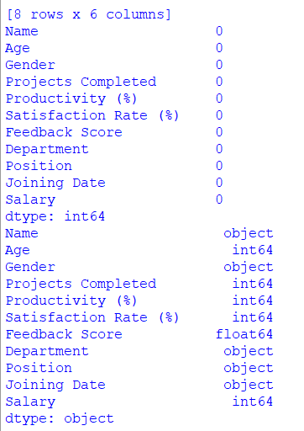
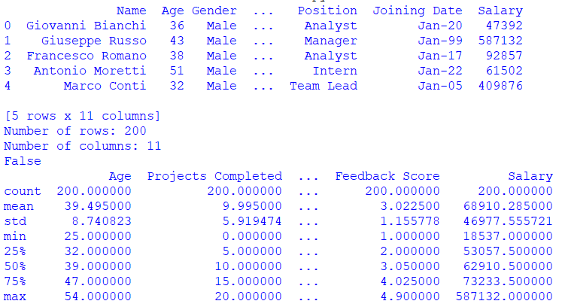

Slide 12
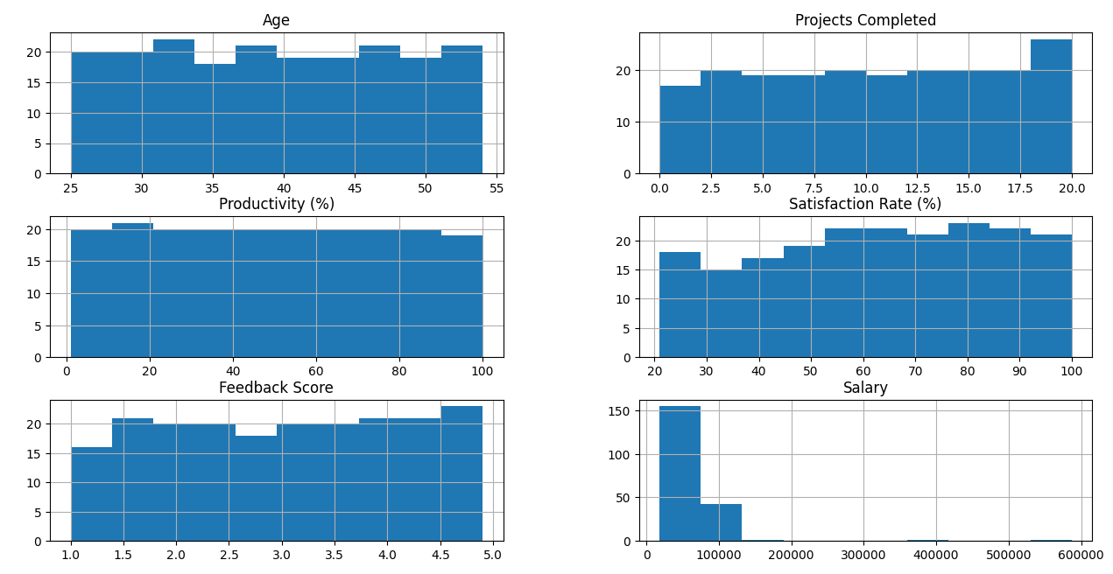

Slide 13
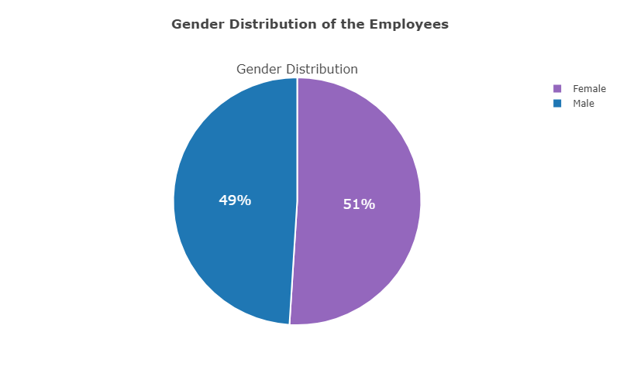

Slide 15
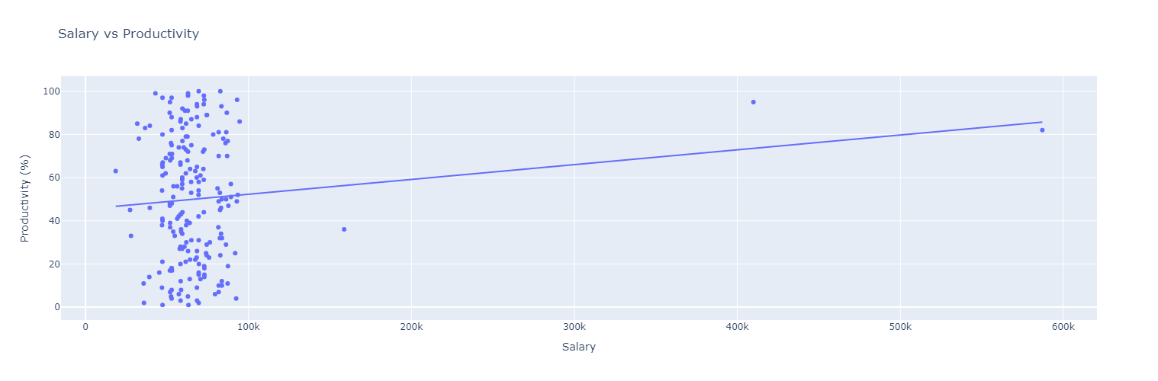
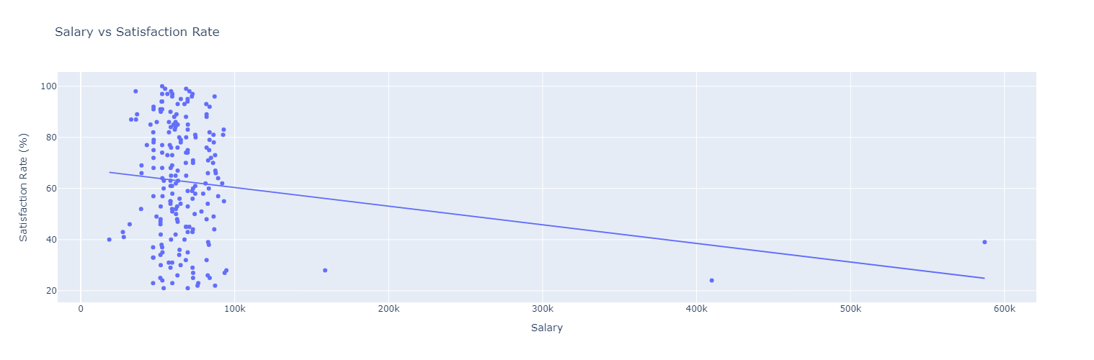
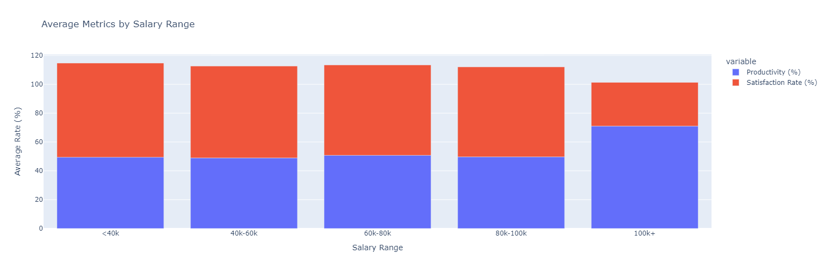
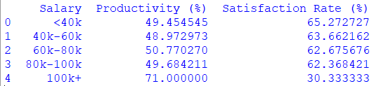

Slide 16
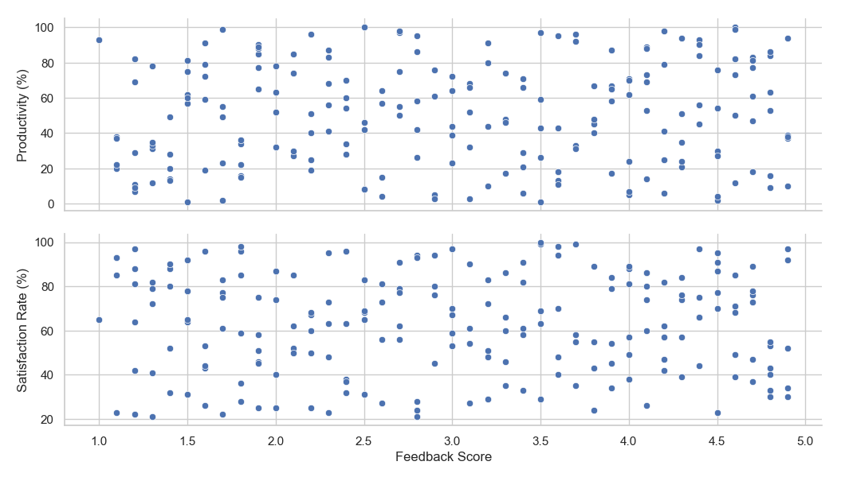

Slide 17
CONCLUSION
The analysis of the employee performance and satisfaction dataset has provided valuable insights into how various factors impact productivity and overall employee satisfaction. By exploring demographic data, we observed that age and gender distributions have subtle but notable effects on productivity and satisfaction rates. Additionally, a correlation analysis revealed that the number of projects completed, along with feedback scores, plays a crucial role in influencing both productivity and satisfaction levels.
The project has also highlighted how salary variations affect employee performance. Higher salary ranges generally correspond to increased productivity and satisfaction, although the relationship is not always linear. Through the regression model and feedback analysis, we identified key areas where employee engagement can be improved, particularly for those with lower feedback scores or those handling heavier workloads.
By incorporating visualizations, the project provided HR professionals with an interactive tool to explore these insights, making it easier to spot trends and patterns in the data. This solution not only offers a deeper understanding of employee behaviour but also serves as a foundation for creating actionable strategies aimed at improving both individual performance and overall organizational efficiency.
The results reinforce the importance of data-driven decision-making in enhancing employee satisfaction and productivity.

Slide 18
FUTURE ENHANCEMENTS
Future enhancements for this project could include integrating more advanced machine learning algorithms, such as decision trees or clustering, to uncover deeper patterns in employee performance and satisfaction. Expanding the dataset to include additional variables like work hours, training opportunities, or employee tenure could provide more comprehensive insights. Implementing real-time data updates and incorporating interactive features like predictive analytics and trend forecasting would further enhance the dashboard’s utility. Additionally, integrating natural language processing for more nuanced sentiment analysis of feedback can offer richer insights into employee sentiments and areas for improvement.

Slide 19
THANK YOU
By
MARIANIHILL A

